Slide 1

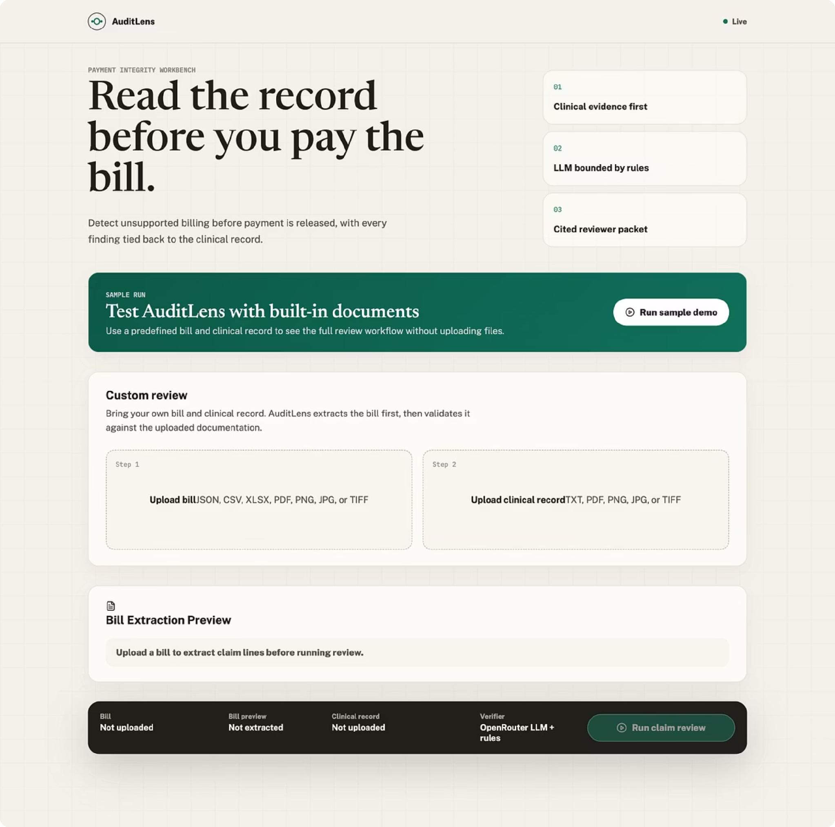
AuditLens AI
Clinical Claim Validation Workbench
Evidence-grounded GenAI for payment integrity review
By Sanika Jadhav

Slide 2
PART A · AUDITLENS AI
The Problem and What AuditLens AI Does
The Gap
AuditLens AI Verifies
Every billed line must be clinically supported before payment
Generic LLM summaries lack defensible, cited findings
Evidence buried in unstructured notes, PDFs, and scans
Manual review is slow; unsupported billing creates payment exposure
Did the service happen? Is there documentation support?
Diagnosis and medical necessity support?
Duplicate, bundled, excessive-unit, or upcoding issues?
Dollars at risk and recommended reviewer action?
Outputs: Line-level status · Cited evidence · Confidence score · Documentation gaps · Risk score · Potential savings

Slide 3
PART A · AUDITLENS AI
End-to-End Workflow
01
02
03
Upload Bill & Clinical Record
Extract Bill Lines & Clinical Facts
Retrieve Relevant Record Passages
Bill and clinical record uploaded by reviewer
System parses bill and extracts clinical facts
Relevant passages retrieved from clinical record
04
05
06
Verify Each Billed Line
Run Deterministic Guardrails
Generate Aggregated Claim Report
Each billed line verified against evidence
Billing rules run as guardrails
Consolidated claim report generated
07
Reviewer Takes Action
Reviewer reviews evidence and decides
Supported bill formats: JSON, CSV, XLSX, PDF, PNG, JPG, TIF, TIFF | Supported clinical record formats: TXT, PDF, PNG, JPG, TIF, TIFF

Slide 4
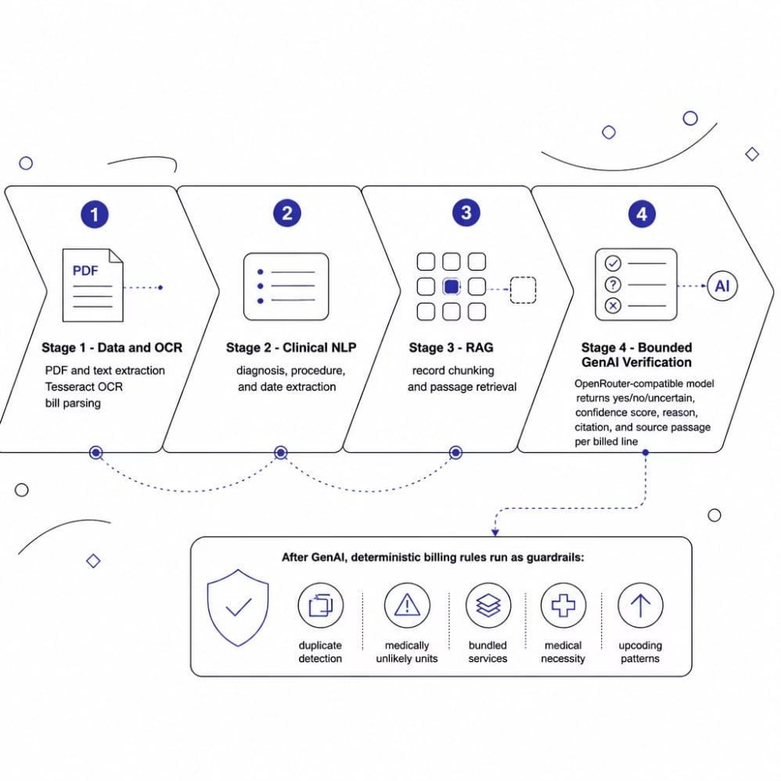
PART A · AUDITLENS AI
Architecture & Controlled AI Design
Stack
Frontend: React/Vite reviewer workbench
Backend: FastAPI pipeline
GenAI: OpenRouter-compatible bounded verification
Storage: SQLite for uploaded and reviewed artifacts
Design Principle
The model answers one narrow question per billed line: "Does this retrieved evidence support this specific service?" It returns yes/no/uncertain, a confidence score, a reason, a citation, and the source passage. Deterministic rules run afterward. Bounded design reduces hallucination risk and keeps output auditable.

Slide 5
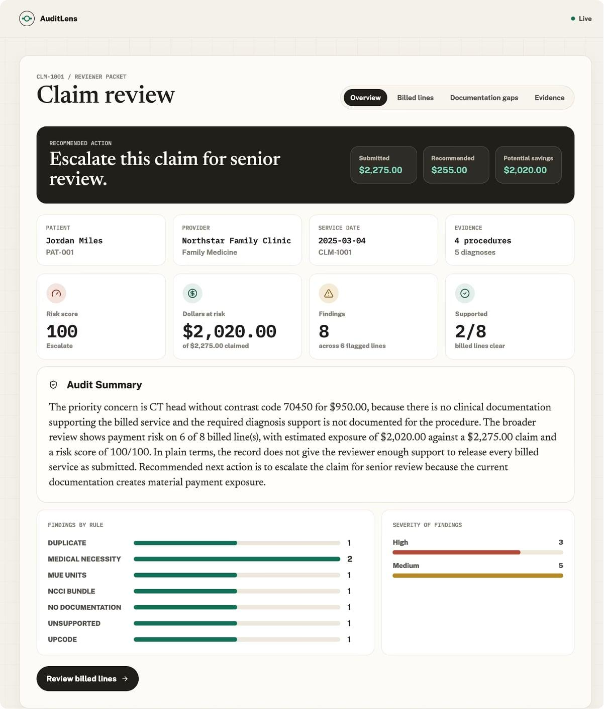
PART A · AUDITLENS AI
Reviewer Workbench & Documentation Gaps
Workbench Features
Claim intake and bill extraction preview
Live analysis progress and claim overview
Billed lines table with line-level evidence review
Documentation gaps and extracted evidence view
Floating record chat and reviewer action buttons
Every Gap Explained
For each problematic service: service name, CPT/HCPCS code, required documentation, what's present, gap type, and amount at risk. Every finding tied to a retrieved clinical passage reviewer can audit the model's reasoning.

Slide 6
PART A · AUDITLENS AI
Business Value for Cotiviti
Payment Exposure Visibility
Reviewer Efficiency
Surface unsupported charges earlier in the payment cycle
Faster pre-payment review with reduced manual friction
Defensible Citations
Human-in-the-Loop Governance
Explainable AI audit trails with consistent reviewer decisions
Measurable through precision, recall, false alarms, and reviewer acceptance

Slide 7
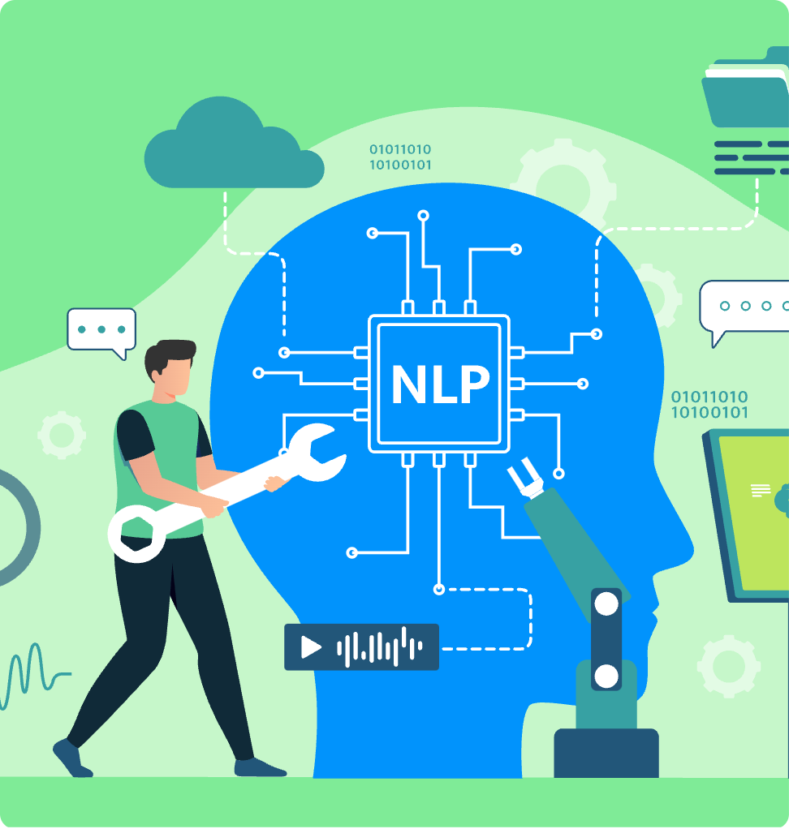

PART B · CLINICAL NLP REPORT
The Technology Landscape - Clinical NLP in Health Care
What It Is
Methods for machines to read and interpret unstructured clinical language — notes, discharge summaries, radiology reports, payer policies. Spans OCR, classical NLP, LLMs, and multimodal models.
~80% of healthcare information is unstructured free text, largely invisible to structured analytics (MarketsandMarkets, 2025).
Technology Arc
Rule-based: MetaMap, cTAKES - transparent but brittle
Transformers: BioBERT, ClinicalBERT (2018–2020)
Generative LLMs: Med-PaLM 2 ~86.5% USMLE accuracy; GPT-4 comparable; Med-Gemini ~91% (Saab et al., 2024)

Slide 8

PART B · CLINICAL NLP REPORT
Market Trends & Opportunity for Payment Integrity
$5.18B
$16.01B
27%
Market Size 2025
Projected by 2030
Coding Improvement
Healthcare NLP market baseline
25.3% CAGR (MarketsandMarkets, 2025)
Ambience ICD-10 model vs. physician benchmarks (May 2025)
Where Adoption Is Concentrating
Automate labor-intensive record reading
Surface coding errors and unsupported charges earlier in the payment cycle
Validate documentation against payer policy at scale
Compress prior-authorization and audit timelines
RAG-grounded citations turn opaque output into a defensible audit trail

Slide 9
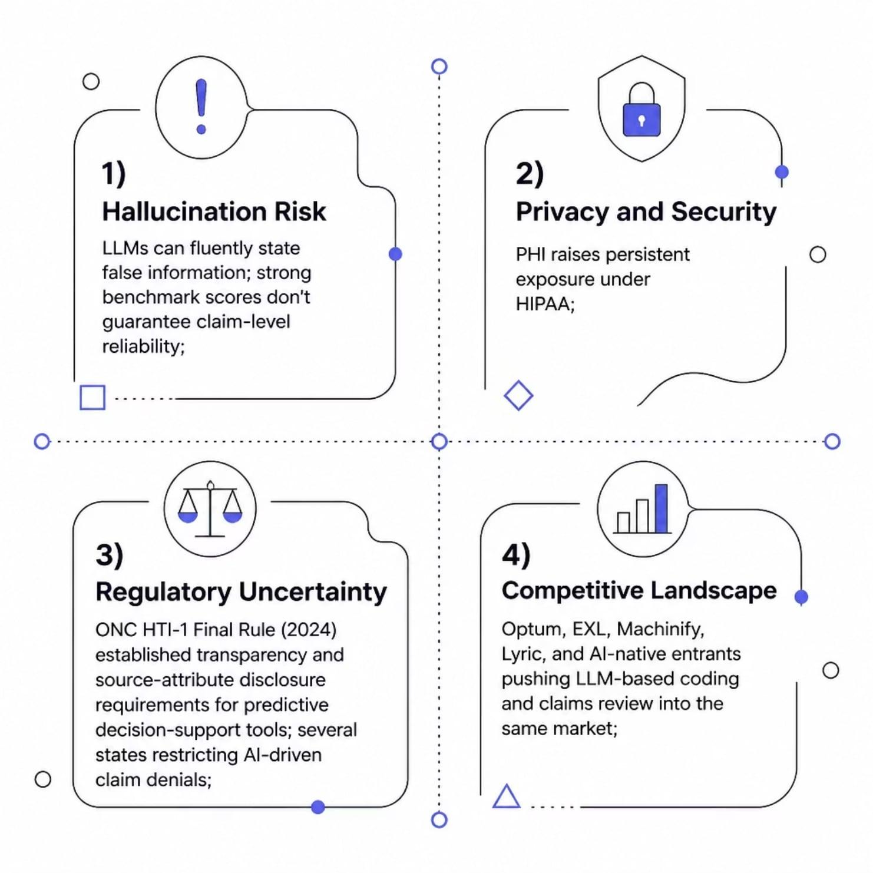
PART B · CLINICAL NLP REPORT
Risks, Regulation & Competition
Key Takeaways
Hallucination risk is unacceptable in clinical and audit settings
PHI raises persistent HIPAA exposure concerns
ONC HTI-1 (2024) established first-of-its-kind transparency requirements for predictive decision-support tools
Several states are restricting AI-driven claim denials; compliance strategy must stay adaptable
Optum, EXL, Machinify, Lyric, and AI-native entrants are all advancing LLM-based coding and claims review

Slide 10

PART B · CLINICAL NLP REPORT
Strategic Recommendation for Cotiviti
1
2
3
Provenance-First RAG Copilots
Agentic Claims-Review Pipelines
Multimodal Record Review
Handle scanned and image-based evidence at scale
Every output cites the source record and payer policy; human reviewer confirms each finding
Decompose claims into checkable steps eligibility, coding, medical necessity with explicit guardrails and full audit logging
"The winning position is not the most autonomous system but the most defensible one."
AuditLens AI is the proof-of-concept: a hybrid deterministic-plus-LLM prototype routing each claim through automated billing-rule checks, retrieval-augmented record matching, and LLM-assisted medical-necessity review grounding every judgment in source documents.

Slide 11
Thank You
I appreciate your time and consideration of AuditLens AI.

